Slide 1
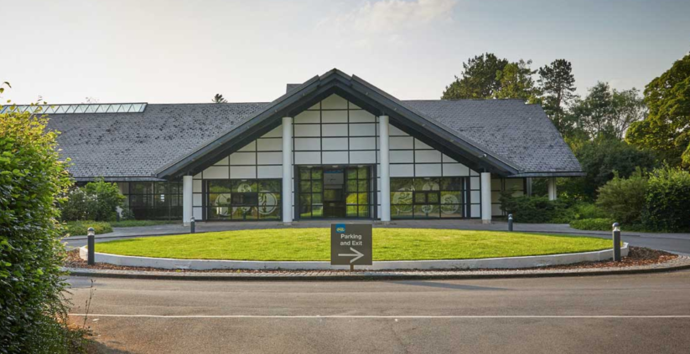
PGL –Parent Information 03.10.24 (12.03.25 – 14.03.25)

Slide 2
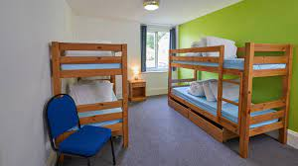
Accommodation
This centre offers fantastic, modern, comfortable accommodation. All the rooms are en-suite and sleep four to six children.
Virtual tour https://www.pgl.co.uk/Files/Templates/Designs/PGLCore/res/swf/virtual-tour/vtour-liddington/tour.html

Slide 3
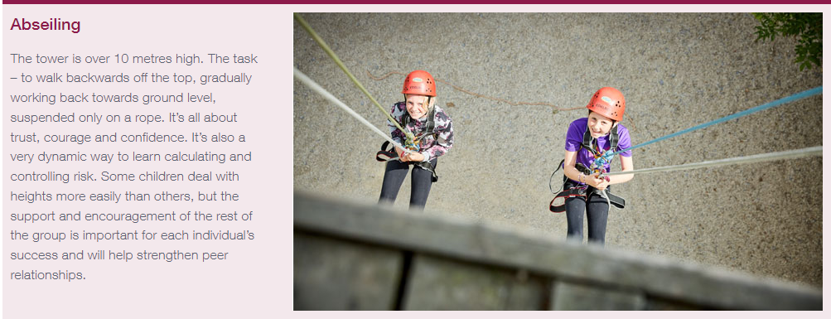
Activities
All PGL's adventure activities take place under the instruction and guidance of specially trained PGL instructors who prioritise safety above all else.
Activities take place on land, on the water and in the air (for our rope-based challenges), so each brings a different (and fun!) way for children to challenge themselves in a friendly, safe and supportive environment.
The final activity programme will be agreed with the Party Leader a few weeks before travel

Slide 4
Sample Day

Slide 5
Food
Lots of choice
As much salad at lunch and dinner as they like
Allergens and special menus
Fussy eaters – no one will go hungry!

Slide 6
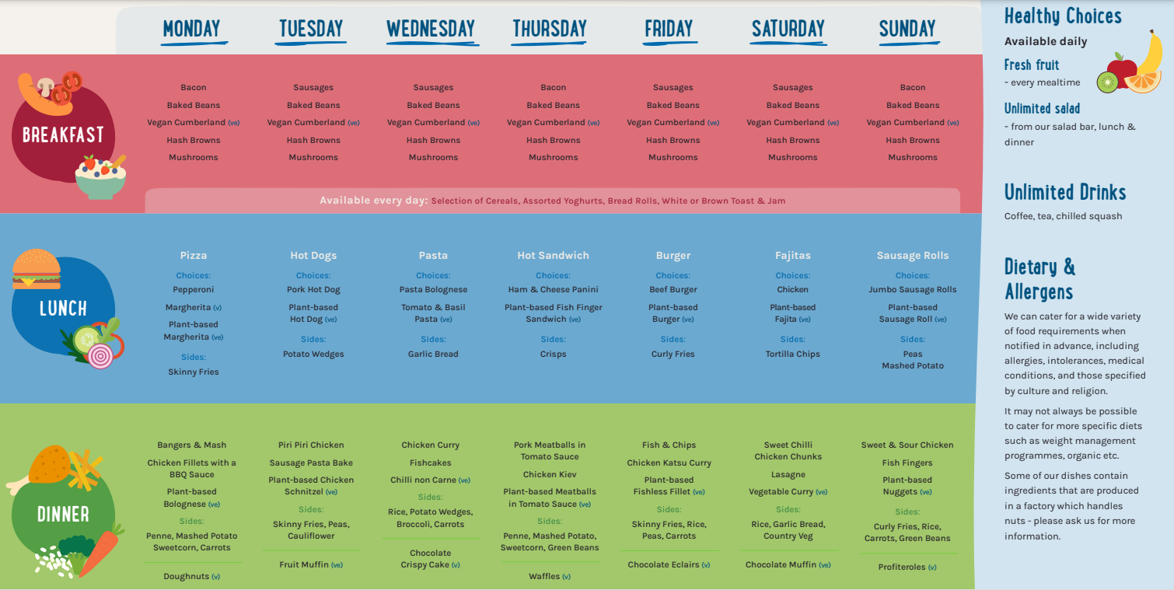

Slide 7
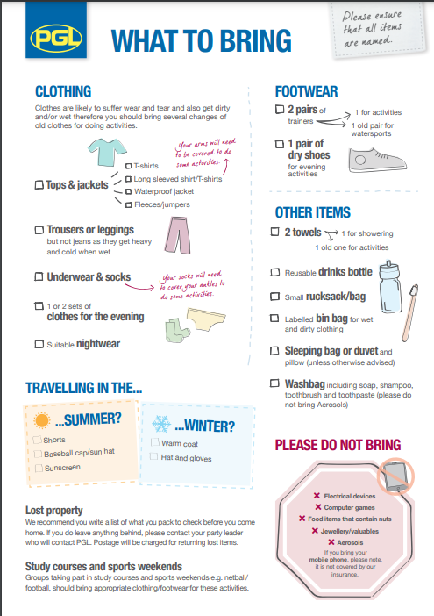
What to Pack
2 coats (not white!) and waterproof trousers
Remember to name everything – including towel
Backpack
Be prepared for all weathers – sun cream, hat and gloves, lip balm
Don’t forget your toothbrush!
Black bag for dirty clothes

Slide 8
What NOT to bring
NO food, including sweets/treats – there will be plenty!
NO phones or other electrical devices
NOTHING valuable
NO jewellery
NO aerosols

Slide 9
Other Information
Get children to pack their bags so they know what is in there
£5 for the shop
Something for the bus e.g. book, drawing, cards
Medication – must have pharmacy sticker with child’s name and dosage information
Travel sickness
Practice making the bed!

Slide 10
A Message to Parents from PGL
Every parent wants their children to explore, have fun and discover more about themselves.
But at the same time we understand that you're bound to have fears and want to protect them– that’s only natural, it’s in our job description!
However, we need to get the balance right between freedom and adventure and care and protection.
It’s a tough line to walk but it’s why we’ve worked so hard since 1957 to perfect our formula and get it right for the thousands of children and parents who holiday and book with us every year.
As a result, our holidays are exciting, full of fun, shared with new friends and enjoyed with laughter but they are also challenging, confidence building and learning experiences.
They offer real, valuable (often life-changing) outdoor adventures, away from home and with other children but most importantly, in safe and hugely stimulating environments. We think that’s what childhood should be all about and what gets the balance right for everyone involved.

